Slide 1

Aluminum Falcon Overdrive
Christopher Christensen
Lead Designer, Level Designer
Garrett Huxtable
Technical Lead, Weapons Designer
Travis Moore
Lead Artist, UX Designer
Michael Van Zant
Producer, Mechanics Designer

Slide 2
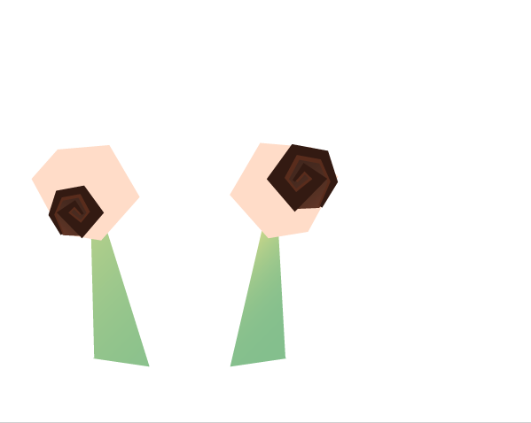
Project SNAIL
Snail is a 2D arcade-style platforming experience!
Snail features simple controls, modular level design that increase in difficulty, and features fun power-ups!

Slide 3

Our Hero, Snail
Snail is fast, friendly, and has gas…
Snail’s shell changes based on which power-up it currently has. Right now the snail has the goo power-up which allows him to burp up goo.

Slide 4


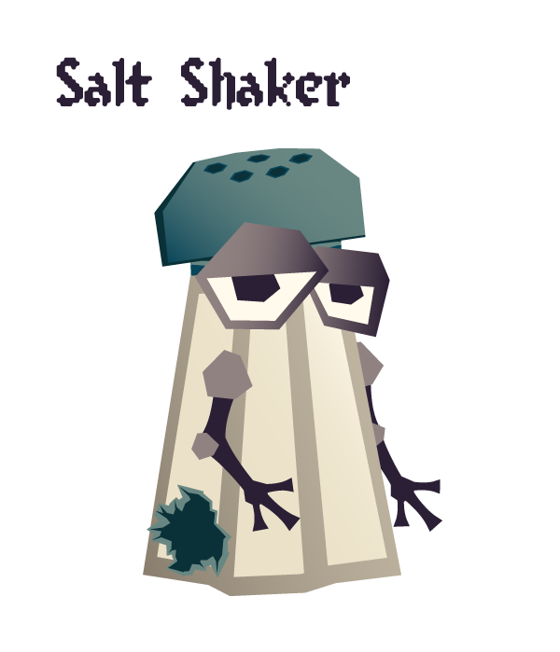
Snail’s Enemies
Snail seems to offend enemies such as these…

Slide 5
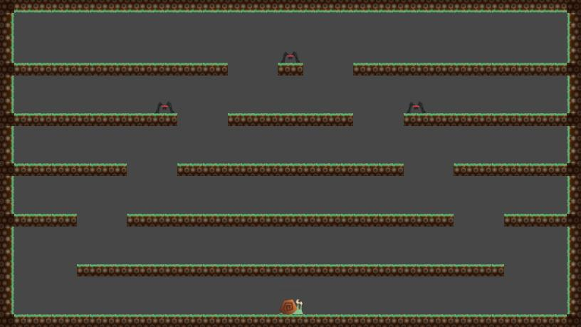
Basic Level

Slide 6
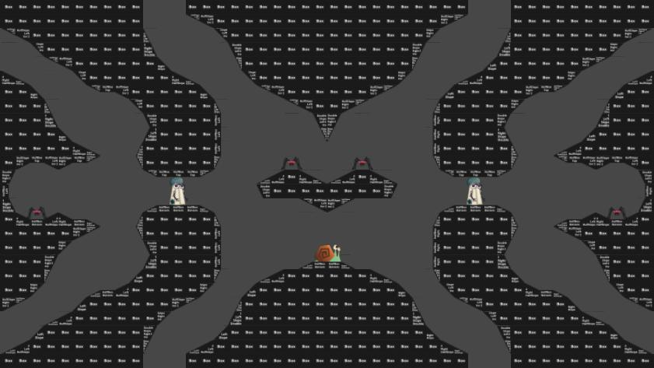
Advanced Level

Slide 7

Let’s Do This!
(chris hates this phrase)

Slide 8

Next Milestone
More Levels…
More Enemies…
MORE POWER-UPS!
(also level transitions and playtesting)

Slide 9

Risks
Polish
Ensuring we implement all mechanics and art assets
Final Boss
Implement a climactic final battle for the player
Consistency
All components of the game must work well together.
Code Requirement
Making sure all members have their code requirements.

